Slide 1
Biodots
Wellness:
See it. Feel it.

Slide 2
Stress
Stress is a state of high energy & normal part of your day-to-day life
- High nervous energy before an exam or performance
- Overwhelm when you have too much to do
- Excitement before an event
During stress, the Sympathetic Nervous System can move blood from your peripheral body parts to your organs
- This can cause the temperature to drop in your hands & feet
- This is why your hands might feel cold before a presentation, exam or performance
Notes:
Stress is a normal part of our day to day lives and is a state of high energy. Stress isn’t good or bad, but you can experience it in different ways. For example, high levels of nervous energy might occur before a performance or exam, while feelings of overwhelm might occur when you’ve got too much to do. Or you might feel excited in anticipation for an event.
During periods of stress, the sympathetic nervous system can move blood from your peripheral body parts, such as your hands and feet, to your organs. This can cause the temperature in these areas to drop. This is why your hands might feel cold right before you give a presentation, sit for an exam, or perform in a concert.

Slide 3
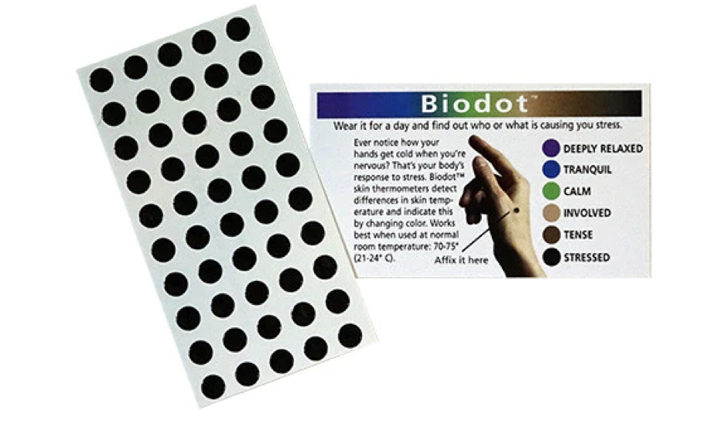
Biodots
Biodots change colour depending on the temperature of your hand
They can provide real time feedback on your levels of stress or focus
Notes:
Biodots are small dots that stick to the back of your hand and reflect your body temperature as a spectrum of colours.
Biodots change colour depending on your skin temperature and can provide real time data to your levels of stress or focus.
Place the Biodot on the back of your hand between your thumb and pointer finger.
The Biodot can stay here for the entire session.

Slide 4
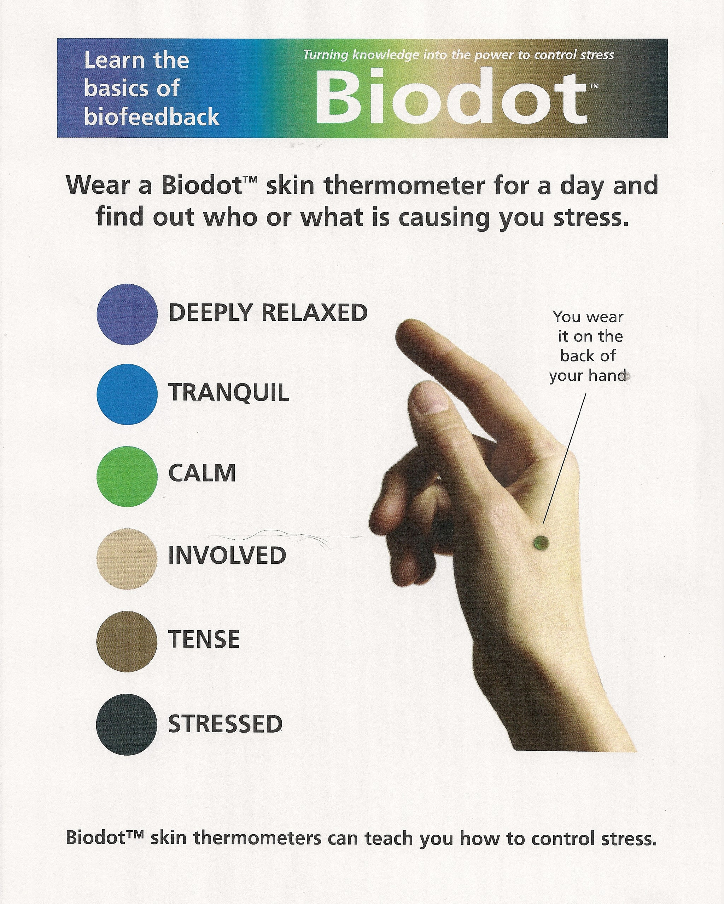
Place the Biodot on the back of your hand between your thumb and pointer finger Notice the colour of the Biodot What colour is everyone’s dots – how does this compare with the colours on the Biodot colour sheet?
Biodot Activity 1
Notes:
You can generate a class discussion or create a list around the colour of everyone’s dots

Slide 5
Complete 20 star jumps – is there any change in the Biodot colour? Consider why there might/might not have been a change
Biodot Activity 2
Notes:
Reasons for colour change to more relaxed:
Increase in hand temperature due to exercise increasing blood flow to the hands
Change in level of focus while completing task – when focusing without effort (i.e. ‘in the zone’) you can be in a more relaxed state; this increases the parasympathetic nervous system response (rest and digest system) which increases blood flow into the extremities
Reasons for colour change to more stressed:
Discomfort with exercising – this increases stress and sympathetic nervous system activation which decreases blood flow to extremities
Effortful focus – trying hard to focus releases adrenaline and is associated with stress (decreased blood flow to extremities)
Blood moving away from hands due to overhead movement
Reasons for no colour change:
Very cold hands

Slide 6
Next Steps
Additional activity: Wear the Biodot for the rest of the day and notice any colour changes – think about what might have prompted these changes
Notes:
Encourage them to wear these biodots at home and at school for a couple of days to notice any patterns that may occur.
Let students know that
Biodots can last up to 24 hrs on your hand.
Moist/oily skin may interfere with adhesiveness.
To re-use place the biodot back on the adhesive backing. It can be reused for as long as it maintains it adhesiveness
Environmental temperature can affect reading.
Temperatures outside of biodot range (30 – 35 degrees Celsius) will turn the dots black
Things that might prompt change:
More stressed:
Raising your hand in class
Sitting an exam
Giving a presentation
Having a disagreement with a friend
More relaxed:
Talking to friends at lunch
Reading
Focused or relaxing activities

